Slide 1
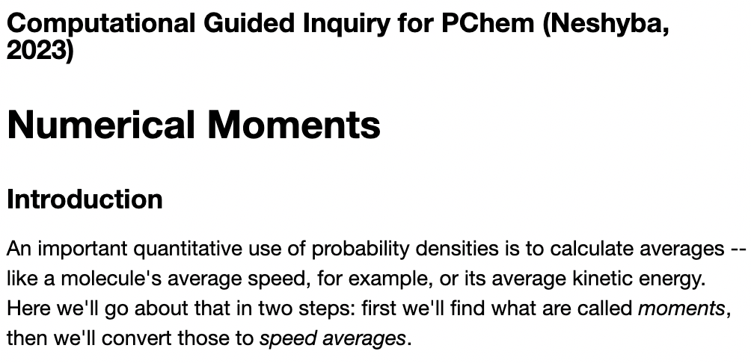
2. The Numerical Moments CGI

Slide 2
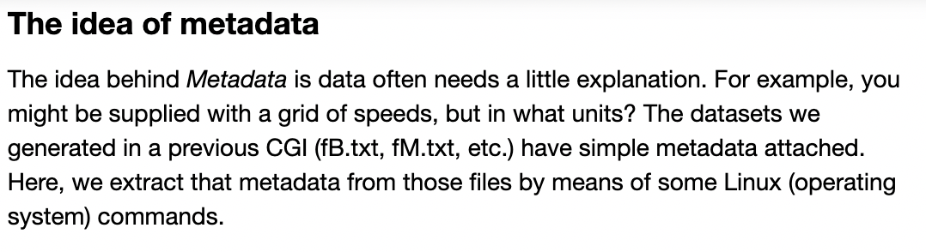
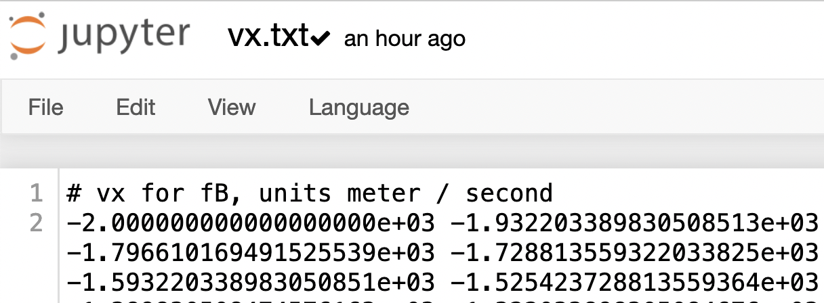
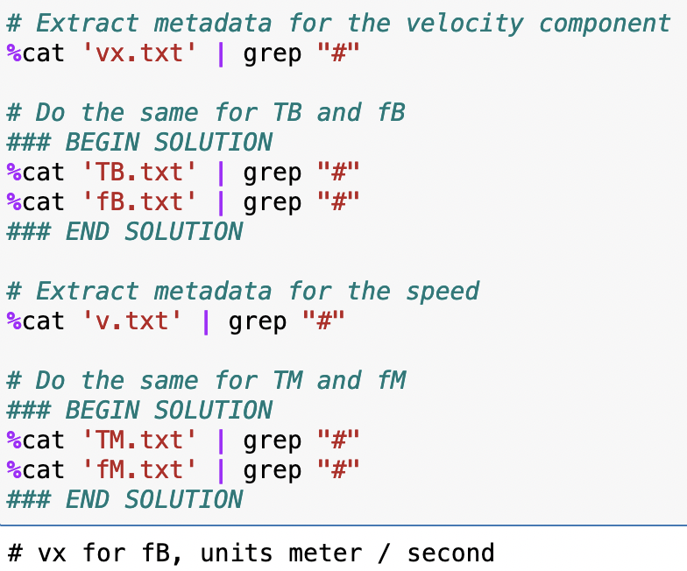
The idea of metadata

Slide 3
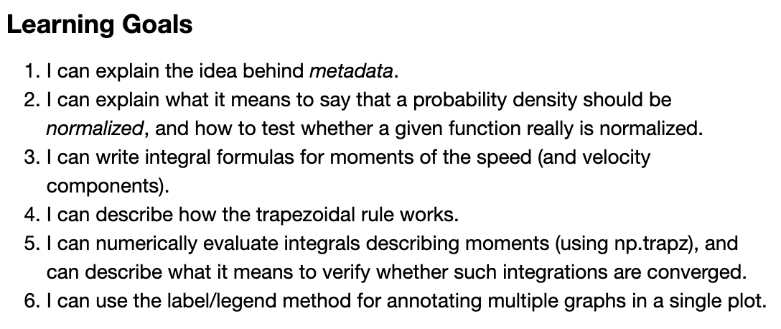
The Numerical Moments CGI – Learning goals

Slide 4
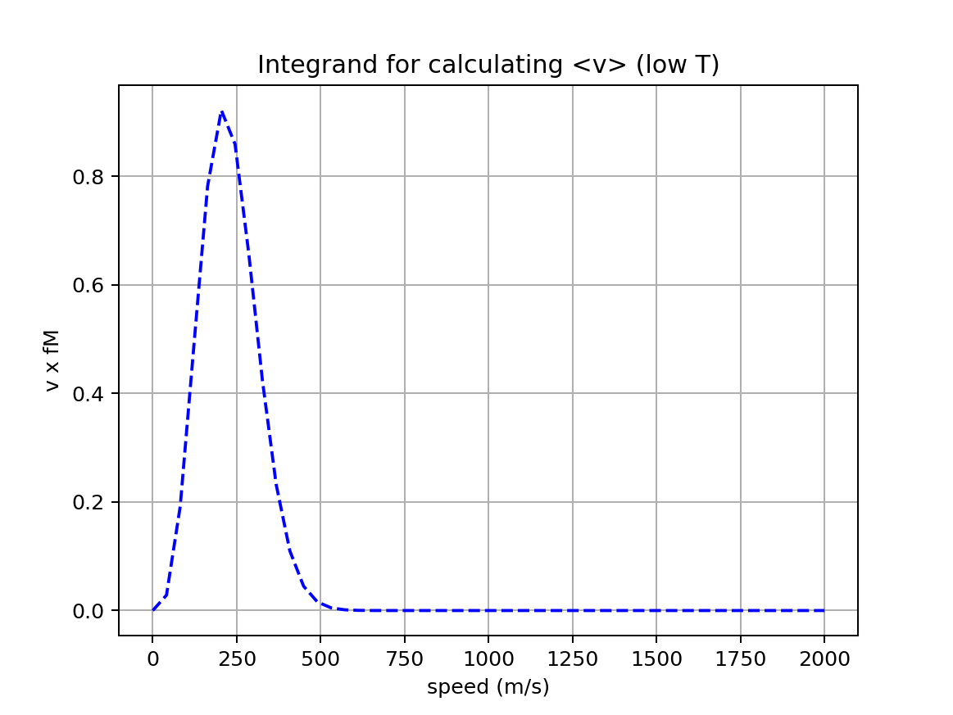
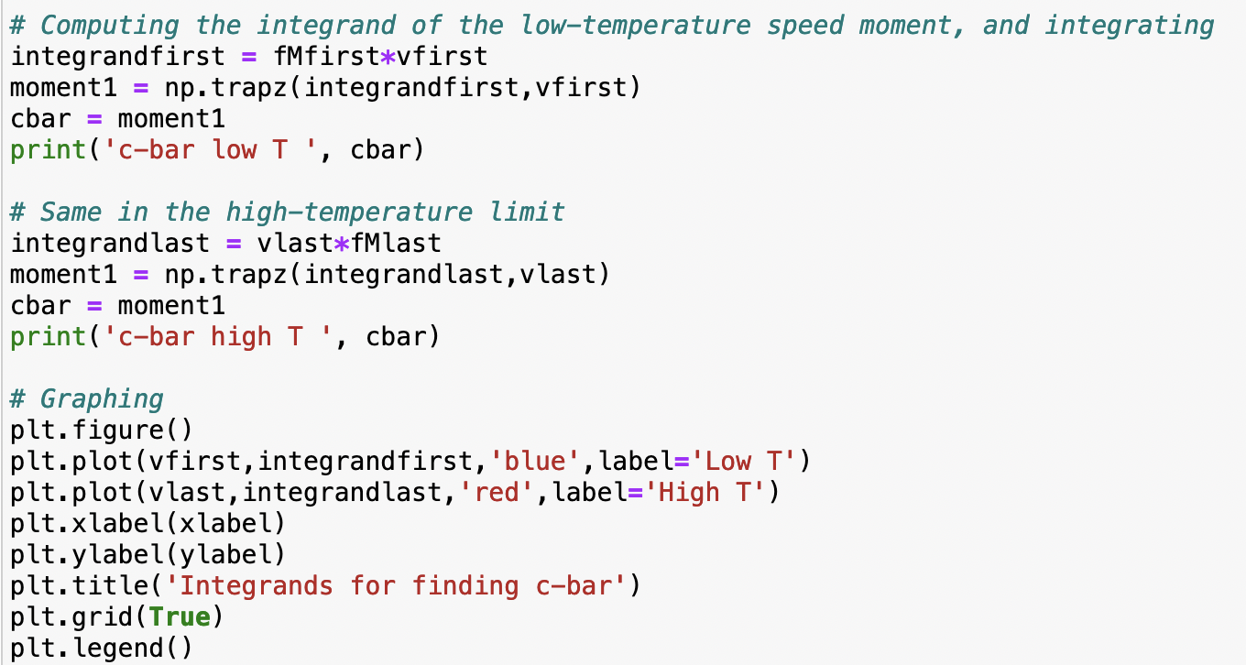
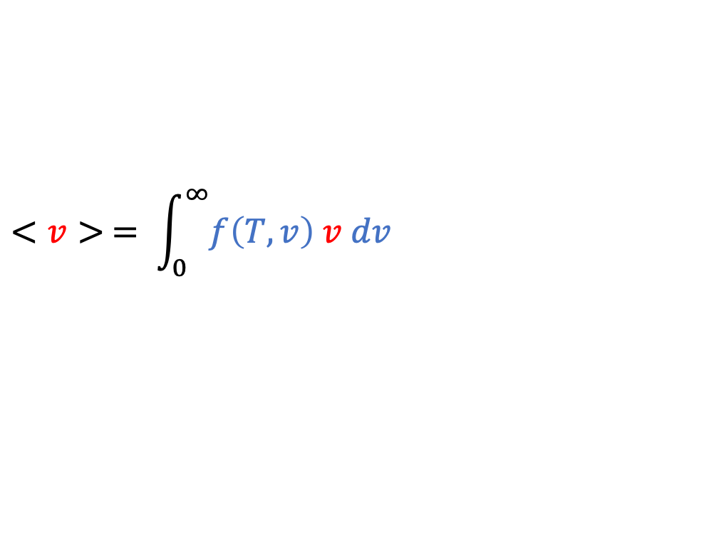
… then we compute and plot the integrand
$$<v> = \int_{0}^{∞}{f\left(T,v\right) v dv}$$

Slide 5
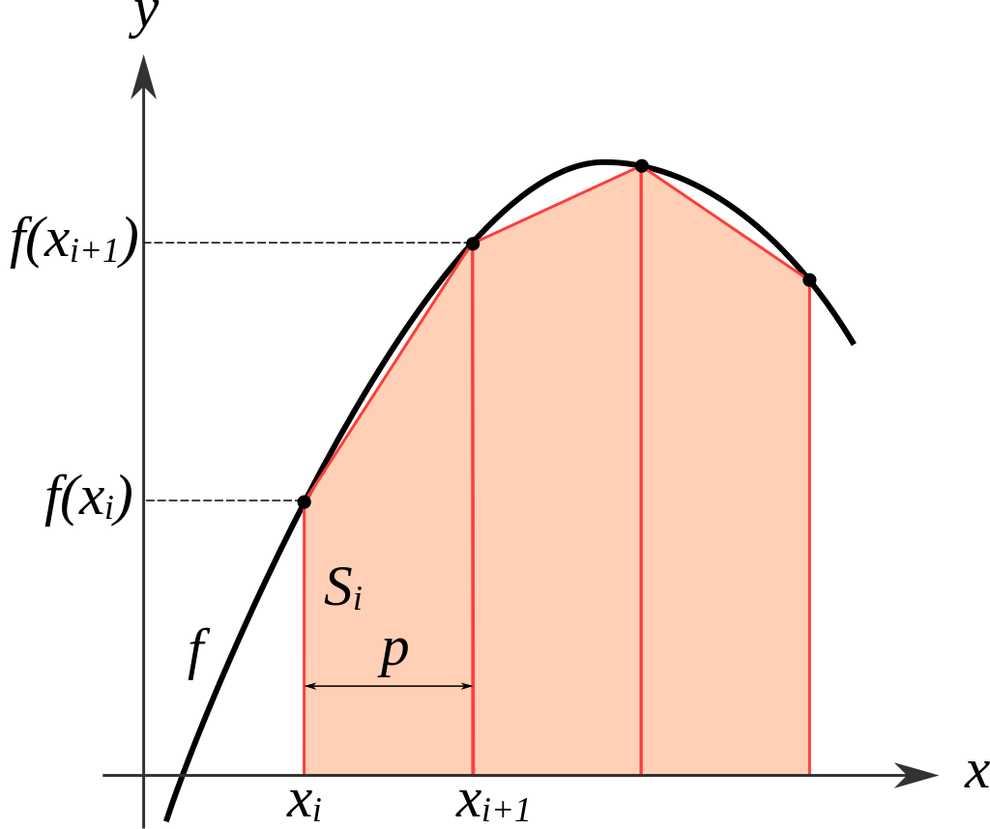
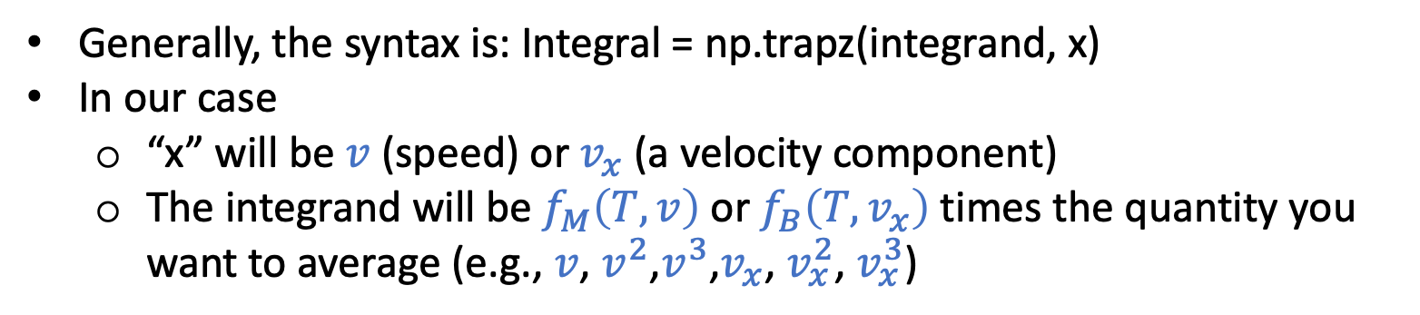
Then we use Python’s trapezoidal rule integrator!
https://en.wikipedia.org/wiki/Trapezoidal_rule
integrand
integral
Generally, the syntax is: Integral = np.trapz(integrand, x)
In our case
“x” will be $v$ (speed) or $v_{x}$ (a velocity component)
The integrand will be $f_{M}\left(T,v\right)$or $f_{B}\left(T,v_{x}\right)$times the quantity you want to average (e.g., $v$, $v^{2}$,$v^{3}$,$v_{x}$, $v_{x}^{2}$, $v_{x}^{3}$)

Slide 6
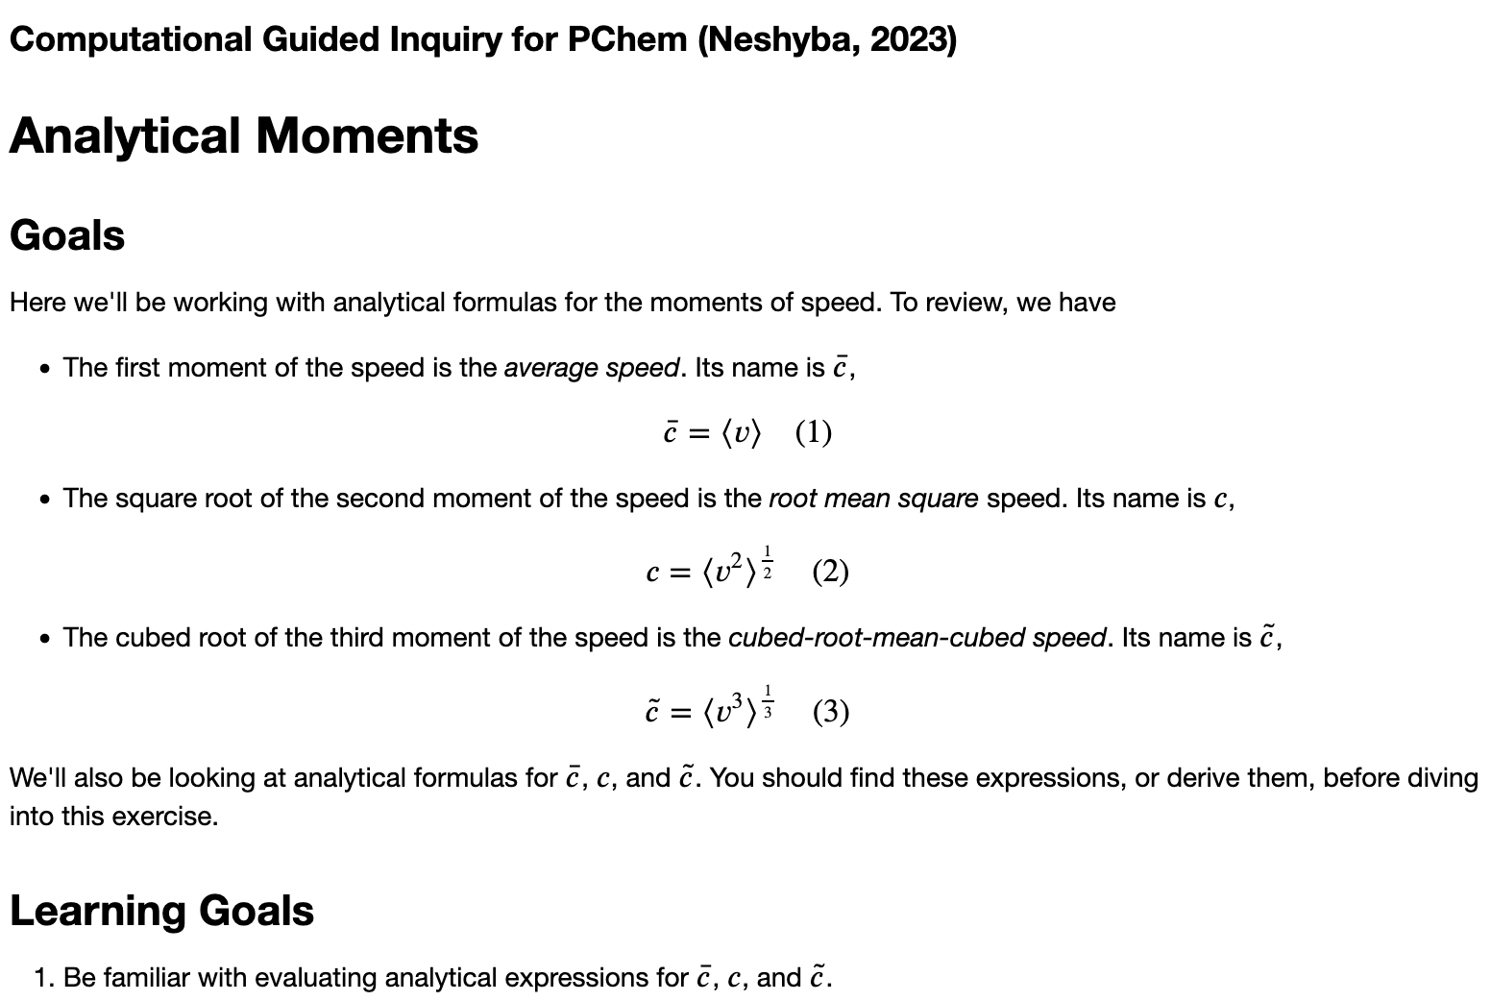
3. Analytical Moments CGI

Slide 7
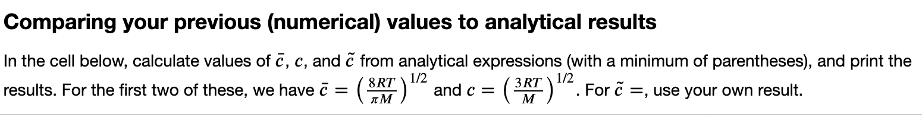
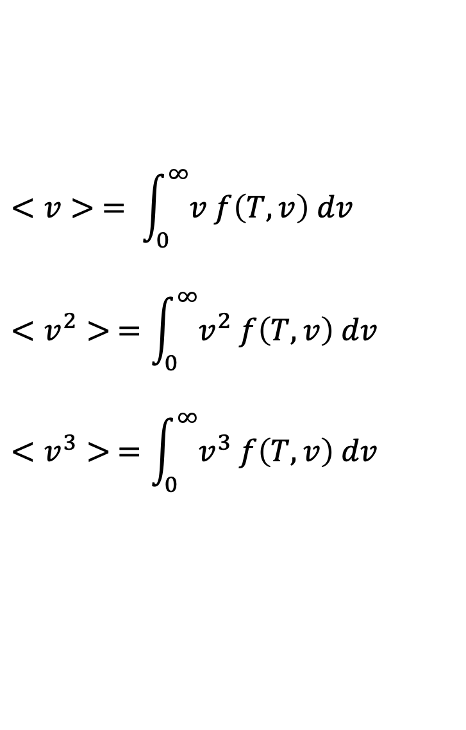
Getting moments ”the old-fashioned way” -- analytical results from integral tables
$$<v> = \int_{0}^{∞}{v f\left(T,v\right) dv}$$
$$<v^{2}> =\int_{0}^{∞}{v^{2} f\left(T,v\right) dv}$$
$$<v^{3}> =\int_{0}^{∞}{v^{3} f\left(T,v\right) dv}$$

